Slide 1
FCR Site 50 @ 0.1m

Slide 2
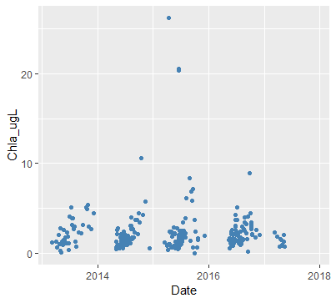
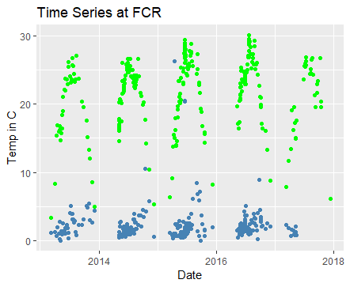
Notes:
Good seasonal spike in T each year, T “slow variable” in regards to chla response

Slide 3
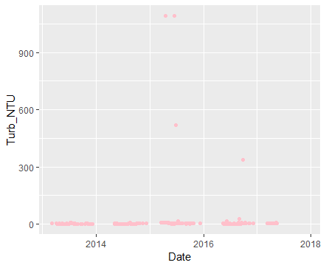
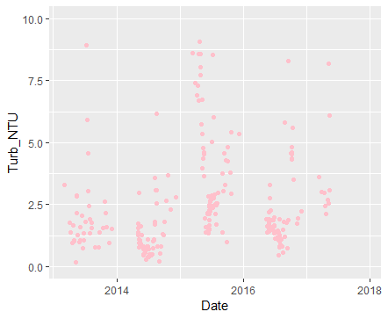
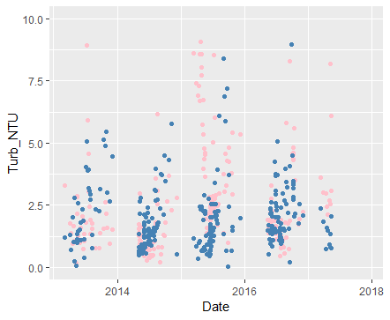
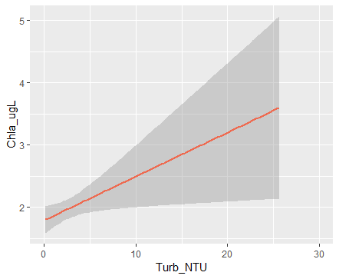
Excluded several outliers from 2015 and 2016 to see general pattern more clearly
Notes:
Lots of NAs for 2017 turbidity
Similar patterns? (R2 of 0.66) Turbidity, mixing of suspended nutrients, perhaps following rain events? Look at met data
Does CTD measure turbidity and chla as discrete things? Could the turbidity sensor pick up phytoplankton in the water column?
When turbidity is low, error bars are low

Slide 4
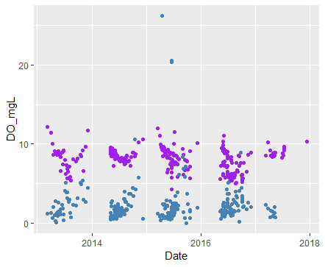
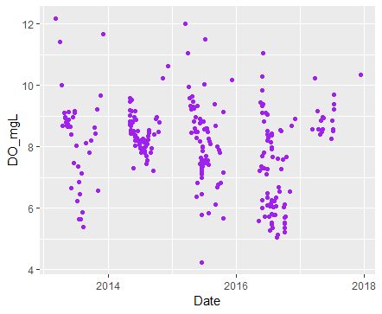
Notes:
Perhaps look at DO in hypo in relation to chla? Bc this is where nutrients will be released from?

Slide 5
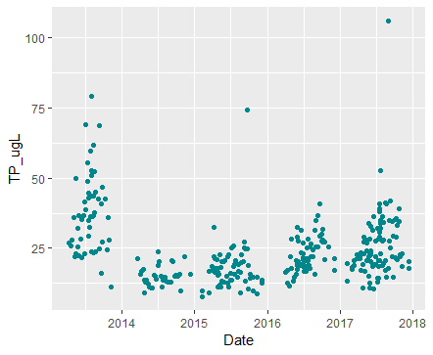
Notes:
High nutrient loading in 2013? Need to match chem and ctd datasets to get them on the same plot and to run a regression
But there is some obvious similarity in pattern; increases in concentration throughout season

Slide 6
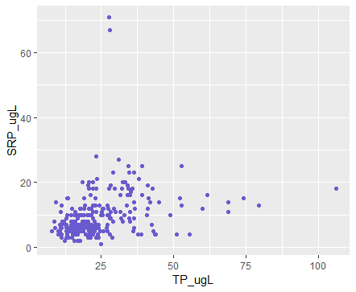
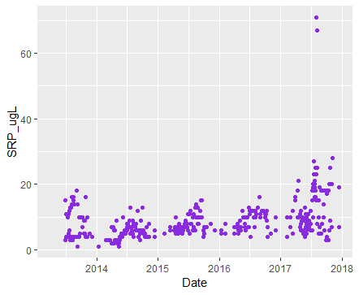
Notes:
Small figure: TP vs. SRP (they are at least loosely related—lm returned sig p value but low r2?)
Again, large spike in SRP in 2017 but no chla data from this time
Similar to TP, increase through season is apparent in both SRP and chla
Will be able to analyze better once chem and ctd datasets are matched

Slide 7
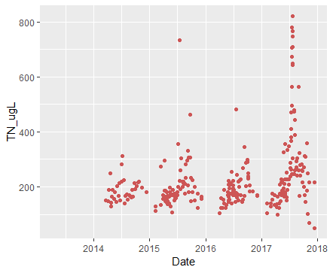
Notes:
Spike in TN in July 18~24 2017, why? Look at met data. Very few chla readings from 2017, why?
In general, TN and Chla seem to follow a similar trend, ie. Increasing throughout the season
A few spikes in 2015, chla response?

Slide 8
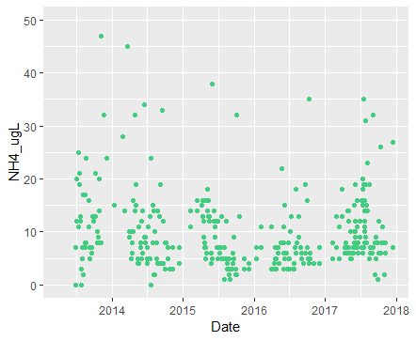
Notes:
What is a useful way to think about ammonia? Internal loading during hypoxic conditions? What is a good range?

Slide 9
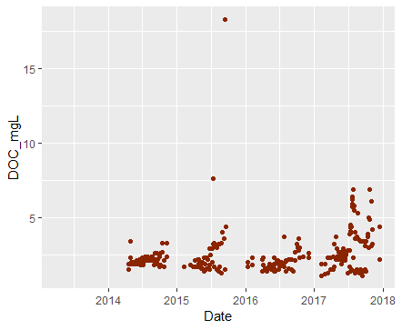
Notes:
DOC somewhat increases over the season. Would be good to look at met data with this

Slide 10
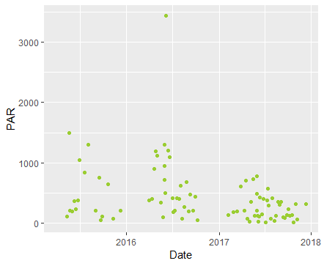
Notes:
Not great coverage of PAR, better data anywhere?
PAR is especially sensitive to TOD, treat this differently to include time when correlating chla values?

Slide 11
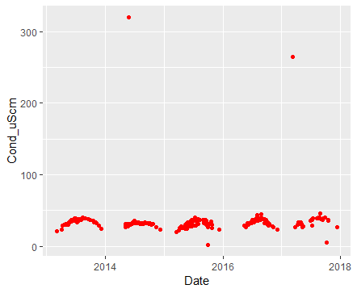
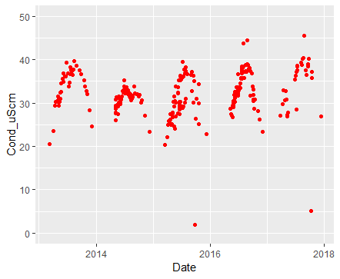
Excluded a few outliers
Notes:
What is role of conductivity?

